Slide 1
Better Together: Text + Context
Kenneth Church

Slide 2

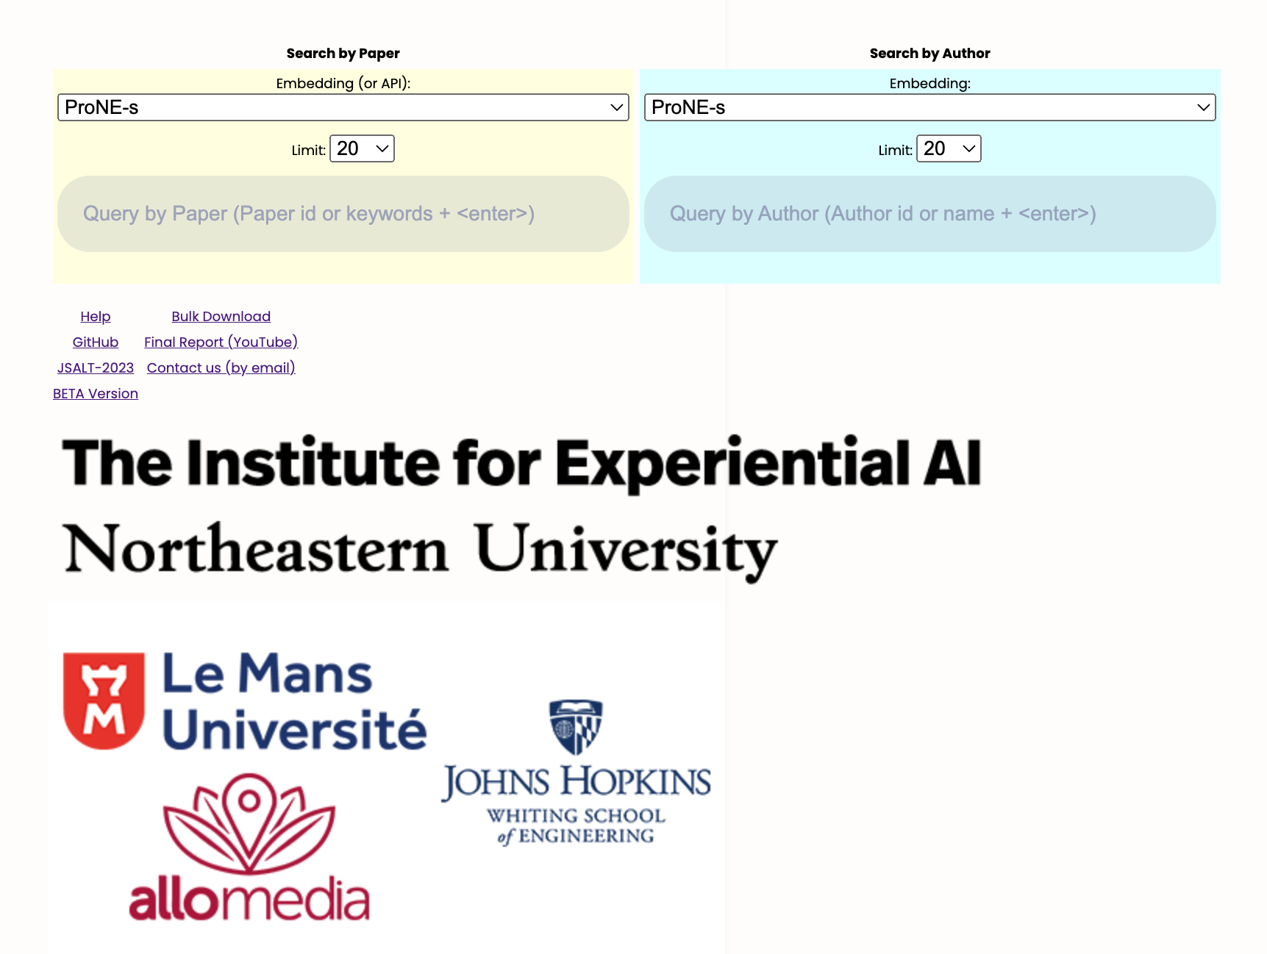

https://www.semanticscholar.org/api-gallery/better-together

Slide 3
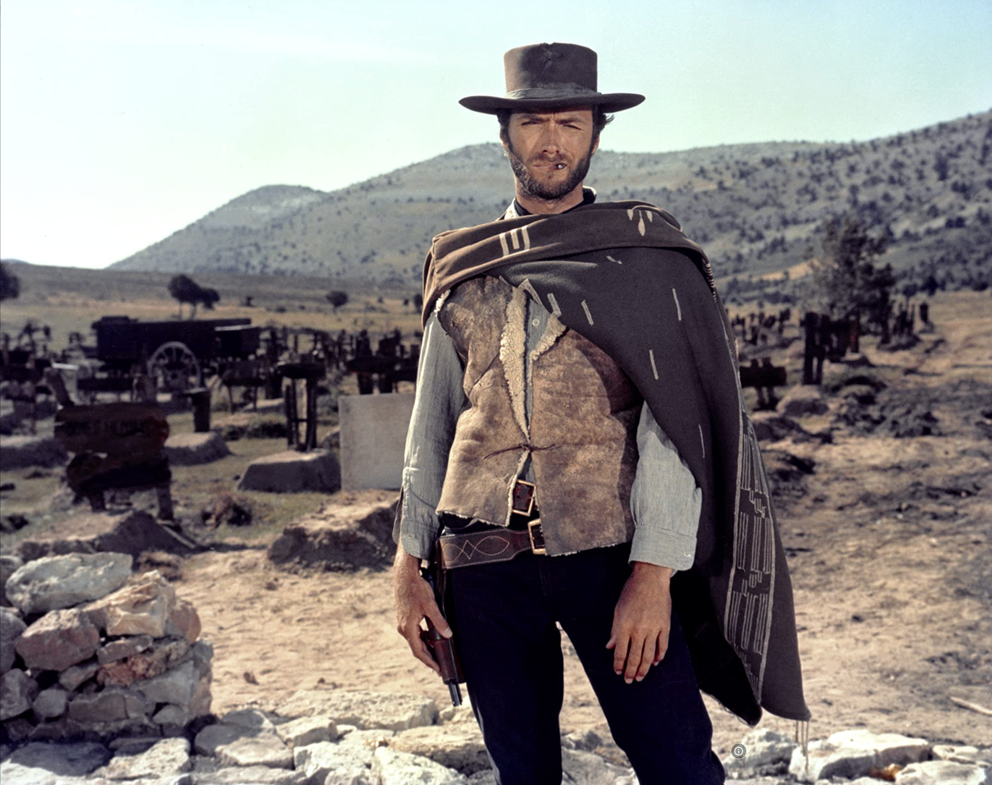

The Easy, the Hard and the Ugly
Easy
Inference (fit)
Fine-Tuning (predict)
Hard
Pre-training
Ugly (Responsible AI)
Bias
Toxicity
Misinformation
Hallucinations
Plagiarism

Slide 4
If you are a researcher or practitioner
What can you do right now without too much effort
Off-the-Shelf APIs
Off-the-Shelf Chatbots
Use case: Academic search domain
Recommendations
Compare and Contrast

Slide 5
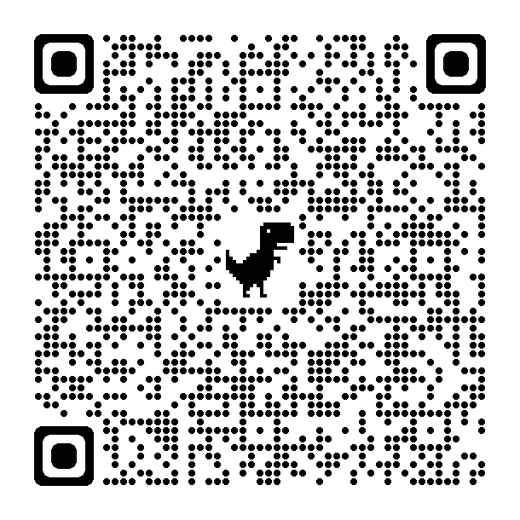
Recommendation API is Super-Easy
Example of S2 (Semantic Scholar) API
https://api.semanticscholar.org/recommendations/v1/papers/forpaper/21321bad706a9f9dbb502588b0bb393cf15fa052?from=all-cs&fields=title,externalIds,citationCount
query: 21321bad706a9f9dbb502588b0bb393cf15fa052
A paper id on Semantic Scholar
Returns recommendations (papers similar to query)
Queries and documents are embedded as vectors
Using Specter, a BERT-like deep net
Search is based on Approximate Nearest Neighbors (FAISS)
from=all-cs: limits search to computer science (about 10% of S2 collection)

Slide 6
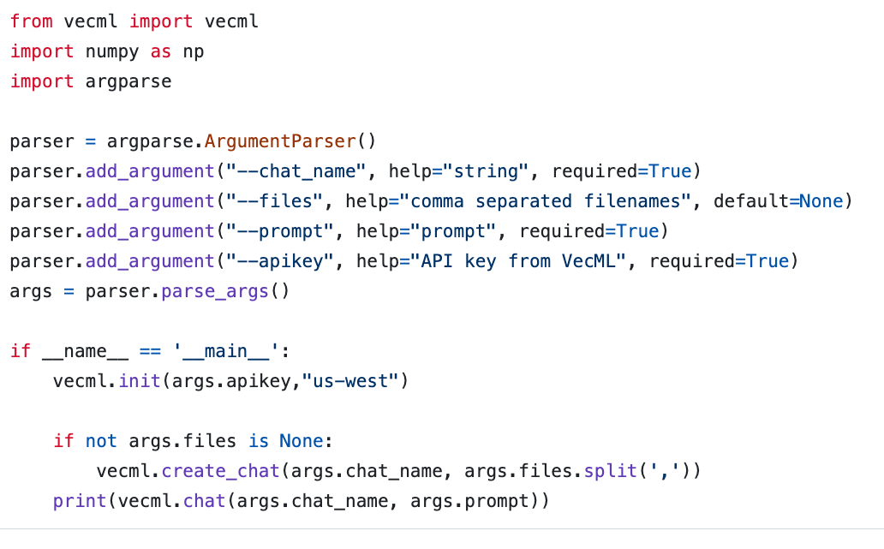
Chatbots are Super-Easy www.vecml.com

Slide 7

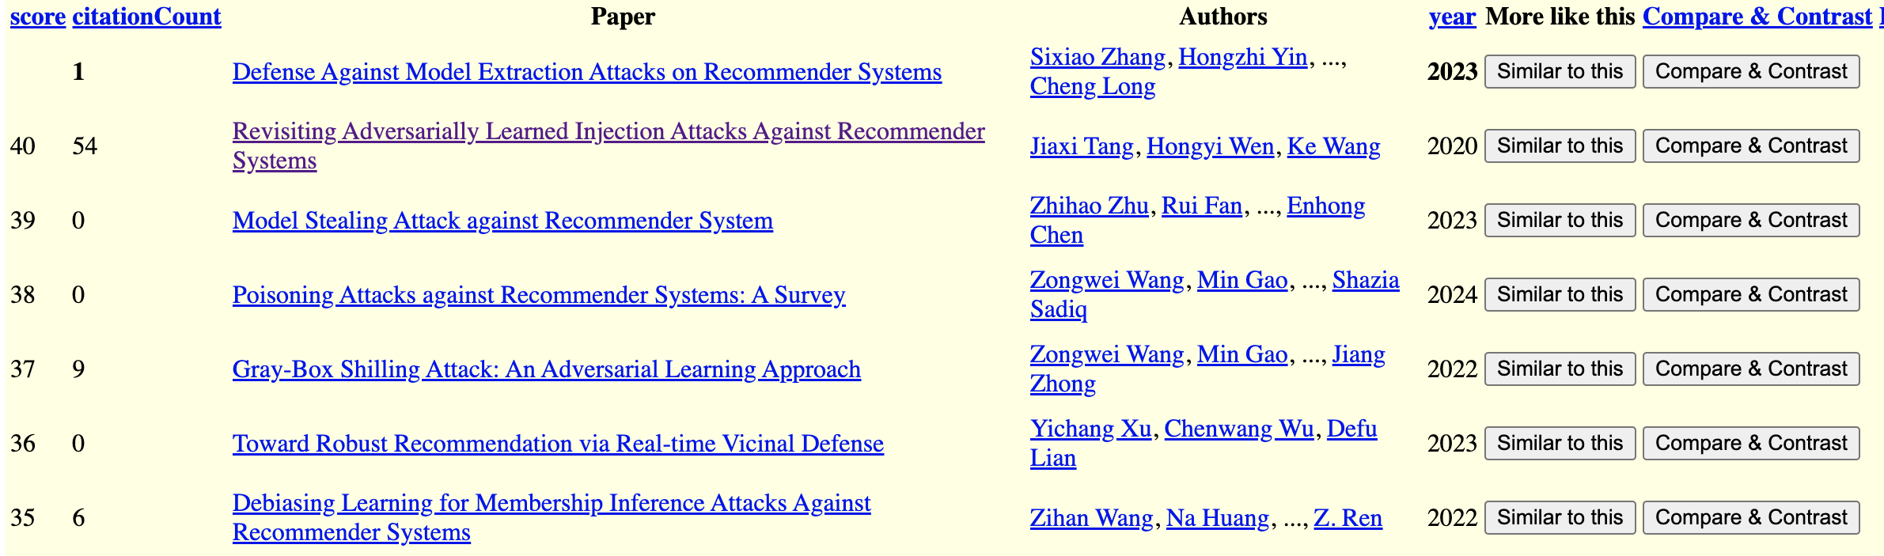
S2 API Recommendations Query: A Paper in WSDM-2024
S2 API
Chatbot

Slide 8
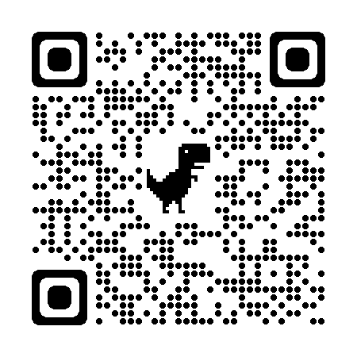
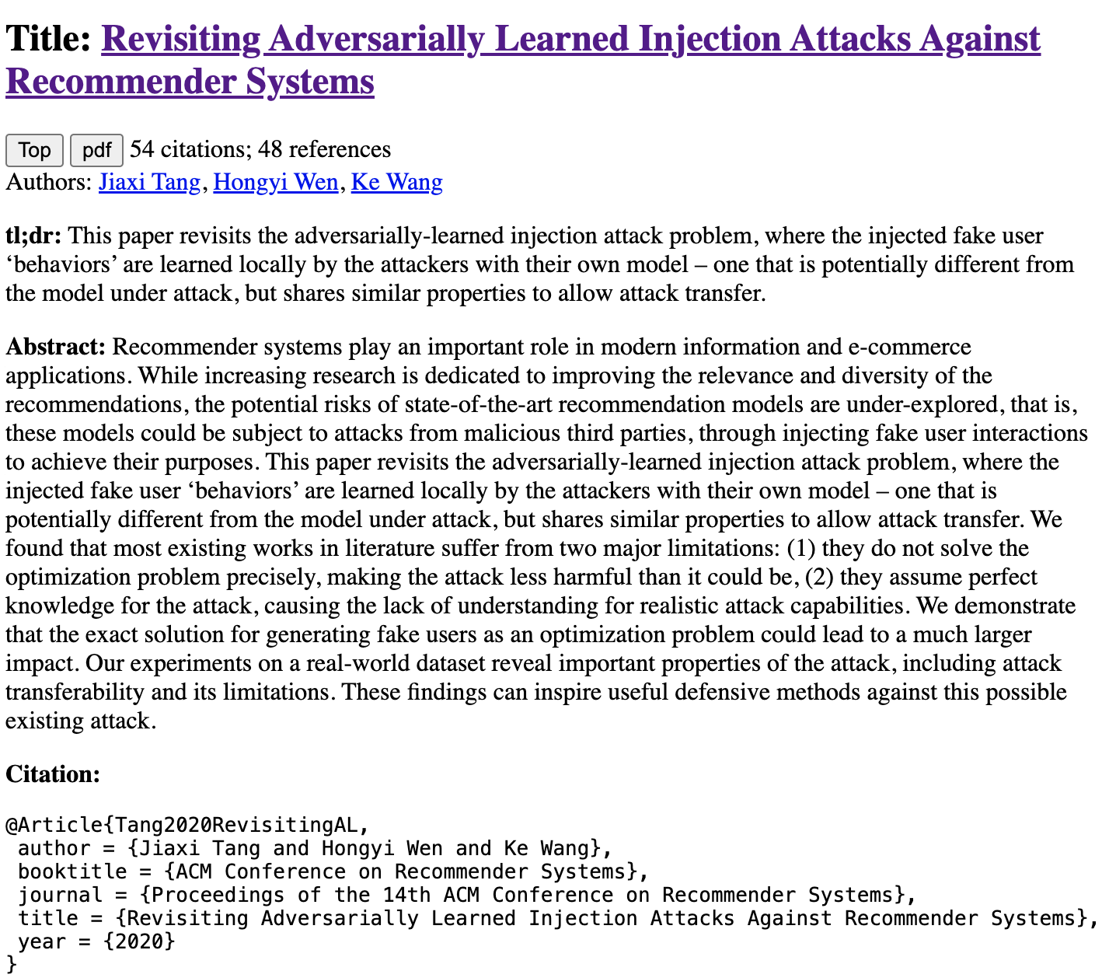
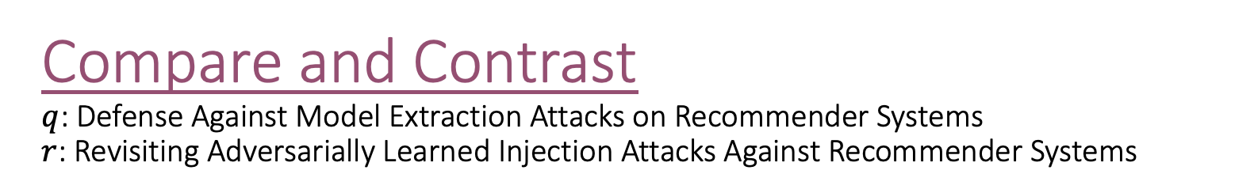
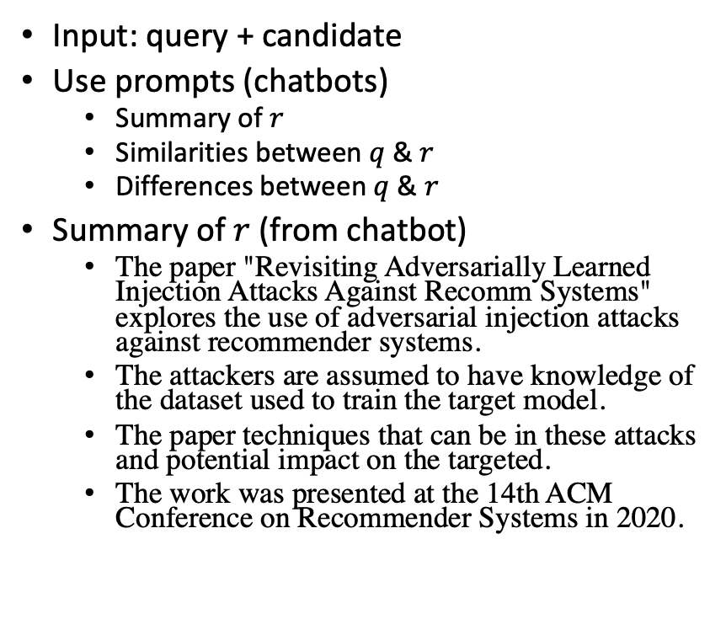
Compare and Contrast $q$: Defense Against Model Extraction Attacks on Recommender Systems $r$: Revisiting Adversarially Learned Injection Attacks Against Recommender Systems
Input: query + candidate
Use prompts (chatbots)
Summary of $r$
Similarities between $q$ & $r$
Differences between $q$ & $r$
Summary of $r$ (from chatbot)
The paper "Revisiting Adversarially Learned Injection Attacks Against Recomm Systems" explores the use of adversarial injection attacks against recommender systems.
The attackers are assumed to have knowledge of the dataset used to train the target model.
The paper techniques that can be in these attacks and potential impact on the targeted.
The work was presented at the 14th ACM Conference on Recommender Systems in 2020.
S2 API
Chatbot

Slide 9

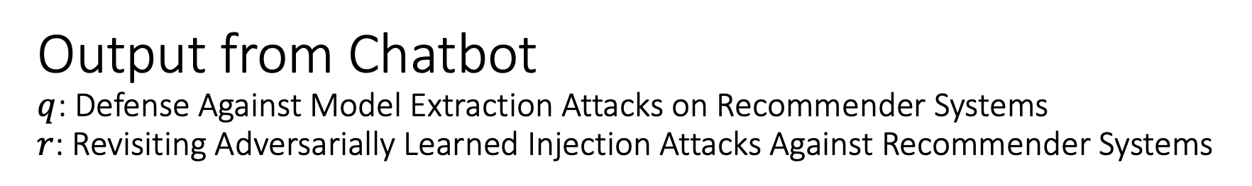

Output from Chatbot $q$: Defense Against Model Extraction Attacks on Recommender Systems $r$: Revisiting Adversarially Learned Injection Attacks Against Recommender Systems
Similarities between $q$ & $r$
Differences between $q$ & $r$
As an Assistant, I can tell you that both
"Revisiting Adversarially Learned Injection Attacks Against Recommender Systems" and
"Defense Against Model Extraction Attacks on Recommender Systems”
focus on security aspects of recommender systems.
The first paper explores injection attacks
where the attacker manipulates the recommendation model by injecting malicious data,
while the second paper deals with defending against model extraction attacks aimed at extracting sensitive information from the recommender system.
Both papers highlight the importance of
addressing security vulnerabilities in recommender systems to protect user data and
maintain the integrity of the recommendation models.
"Revisiting Adversarially Learned Injection Attacks Against Recommender Systems"
focuses on exploring adversarially learned injection attacks against recommender systems,
where the attacker has knowledge about the dataset used to train the target recommendation model.
On the other hand, "Defense Against Model Extraction Attacks on Recommender Systems"
focuses on strategies to defend against model extraction attacks,
where attackers try to extract the architecture or parameters of a recommender system.
The former paper deals with adversarial attacks,
while the latter focuses on defense mechanisms against a different type of attack.
sim?
diff?

Slide 10
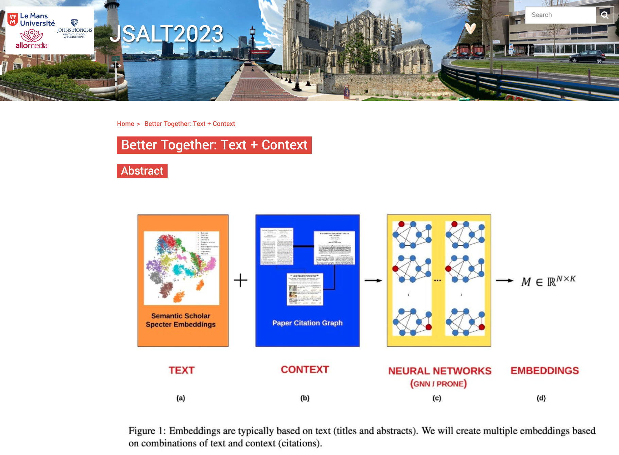
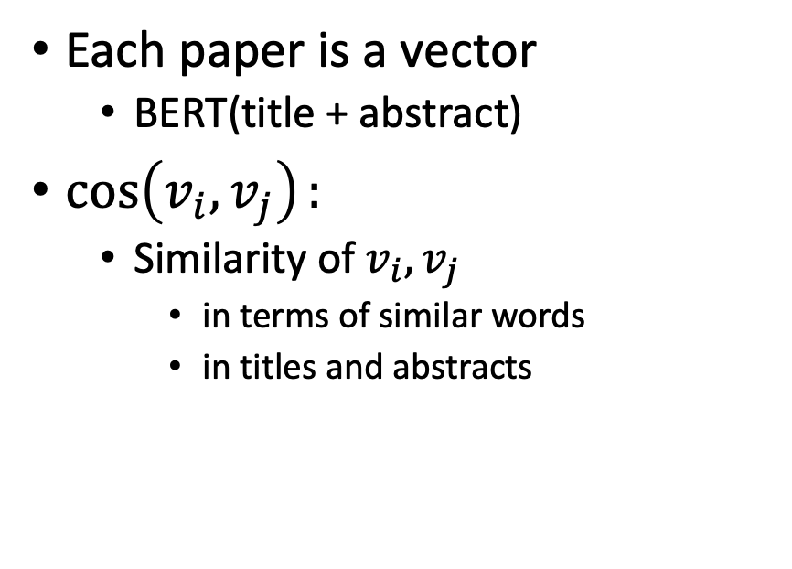
Better Together: Node-based and Edge-based Methods
Node-based Methods (Text)
Edge-based Methods (Citations)
Each paper is a vector
BERT(title + abstract)
$\cos\left(v_{i},v_{j}\right):$
Similarity of $v_{i},v_{j}$
in terms of similar words
in titles and abstracts

Slide 11
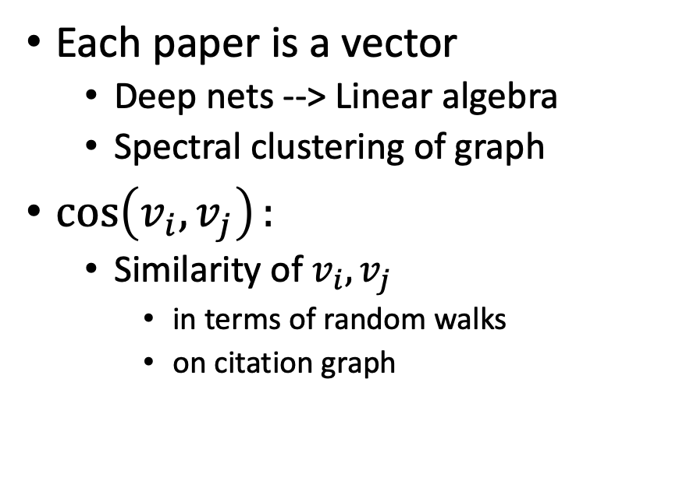
Better Together: Node-based and Edge-based Methods
Node-based Methods (Text)
Edge-based Methods (Citations)
Each paper is a vector
BERT(title + abstract)
$\cos\left(v_{i},v_{j}\right):$
Similarity of $v_{i},v_{j}$
in terms of similar words
in titles and abstracts
Each paper is a vector
Deep nets --> Linear algebra
Spectral clustering of graph
$\cos\left(v_{i},v_{j}\right):$
Similarity of $v_{i},v_{j}$
in terms of random walks
on citation graph

Slide 12
Recommendation Use Cases
Academic Search
For readers:
What should I read?
For authors:
What should I cite?
For conference organizers:
Who should review what?
Finding experts:
Who knows? (Streeter & Lochbaum, 1998)

Slide 13
Recommendation Use Cases
Academic Search
More General Apps of Random Walks
For readers:
What should I read?
For authors:
What should I cite?
For conference organizers:
Who should review what?
Finding experts:
Who knows? (Streeter & Lochbaum, 1998)
Web Search (Page Rank)
Product Search (Amazon)
Finance
Defense/Intelligence
Traffic Analysis

Slide 14
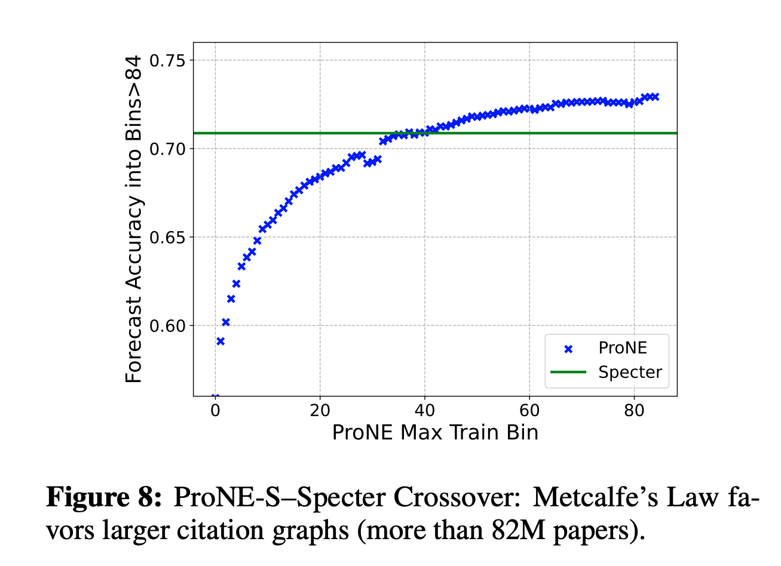
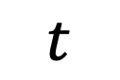
Network Effects: Conjectures
82M Papers
Because nodes scale with n and edges scale with n^2
We expect:
Larger graphs to favor edge-based methods
$$t$$

Slide 15
Network Effects: Conjectures
82M Papers
Because nodes scale with n and edges scale with n^2
We expect:
Larger graphs to favor edge-based methods
Ensembling of node-based and edge-based methods
Should depend on size of training set: t
and forecasting horizon: h
$$t$$

Slide 16
Network Effects: Conjectures
82M Papers
Because nodes scale with n and edges scale with n^2
We expect:
Larger graphs to favor edge-based methods
Ensembling of node-based and edge-based methods
Should depend on size of training set: t
and forecasting horizon: h
Prior literature (benchmarks, GNNs):
Does not attempt to model: scale (t), forecasting (h)
$$t$$

Slide 17
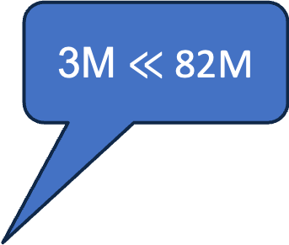
OGB: Open Graph Benchmark Small, Static & Clean
3M Papers
3M $≪$ 82M
Benchmark | #N | #E
ogbl-citation2 | 3M | 31M
Semantic Scholar | 200M | 2B
82M Papers
Notes:
Graph showing growth

Slide 18
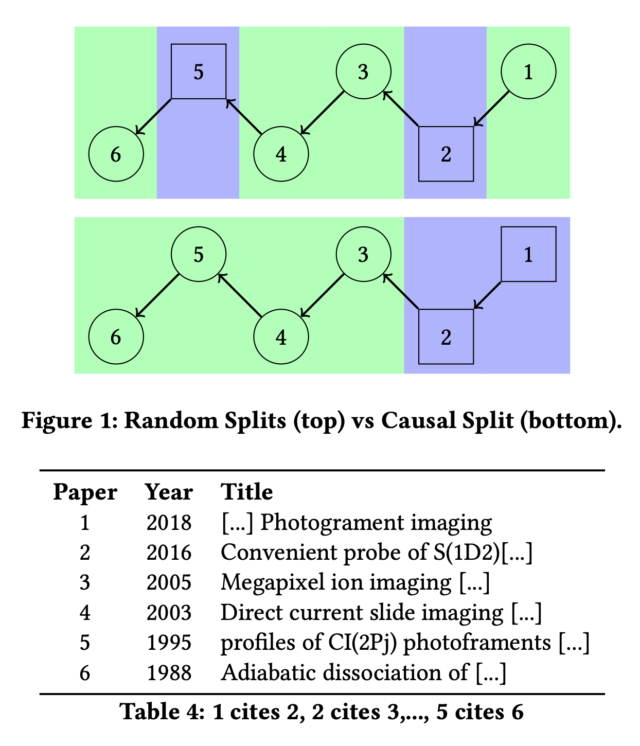
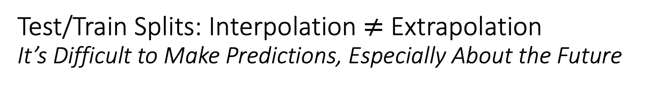
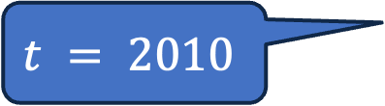
Test/Train Splits: Interpolation $≠$ Extrapolation It’s Difficult to Make Predictions, Especially About the Future
Standard (random) splits
Interpolation
Proposed (causal) splits
Extrapolation (Predictions)
OGB
$$t = 2010$$

Slide 19
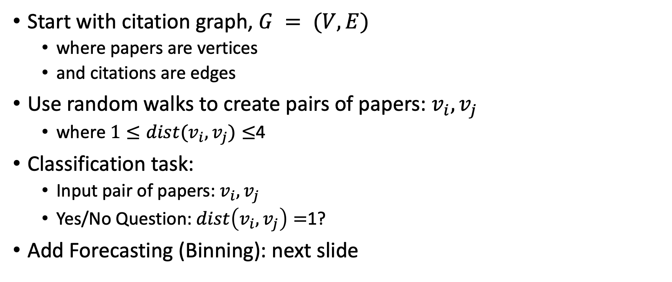
Link Prediction Task: Intrinsic Evaluation
Start with citation graph, $G = (V, E)$
where papers are vertices
and citations are edges
Use random walks to create pairs of papers: $v_{i},v_{j}$
where $1≤dist(v_{i},v_{j})≤$4
Classification task:
Input pair of papers: $v_{i},v_{j}$
Yes/No Question: $dist\left(v_{i},v_{j}\right)=$1?
Add Forecasting (Binning): next slide

Slide 20
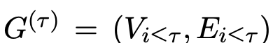
Add Forecasting (Binning)
Split 200M papers into 100 bins
Rank papers by publication date
First 2M papers → bin0
Next 2M papers → bin1
Construct 100 graphs:
that include papers (vertices) in the current bin or previous bins
and citations (edges) from these papers to papers in the current bin or previous bins
Construct 100 ProNE-s models with spectral clustering,
One for each graph

Slide 21
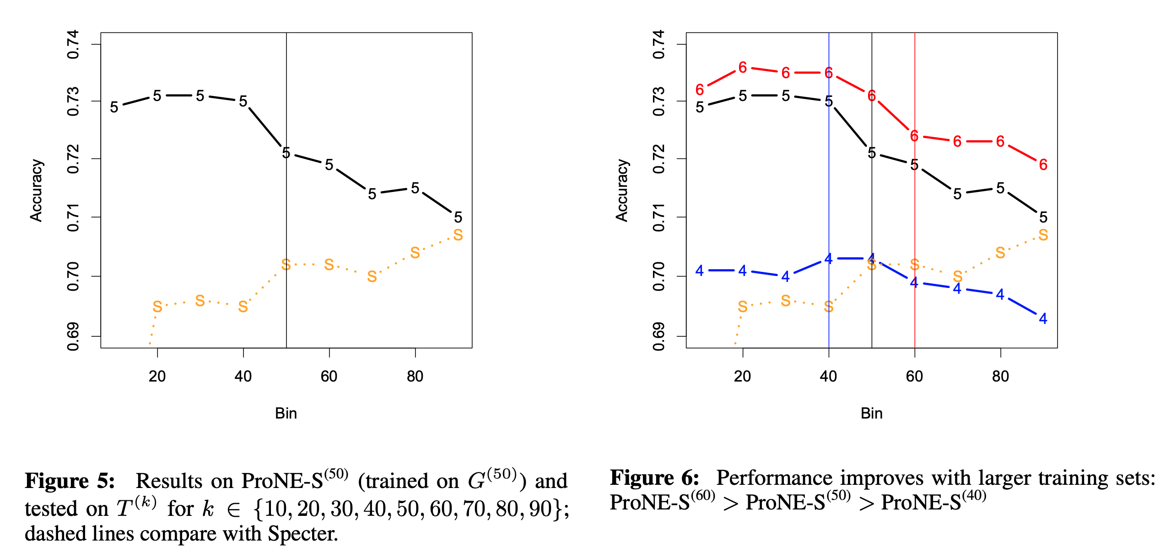
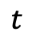
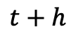
$$t$$
$$t+h$$

Slide 22
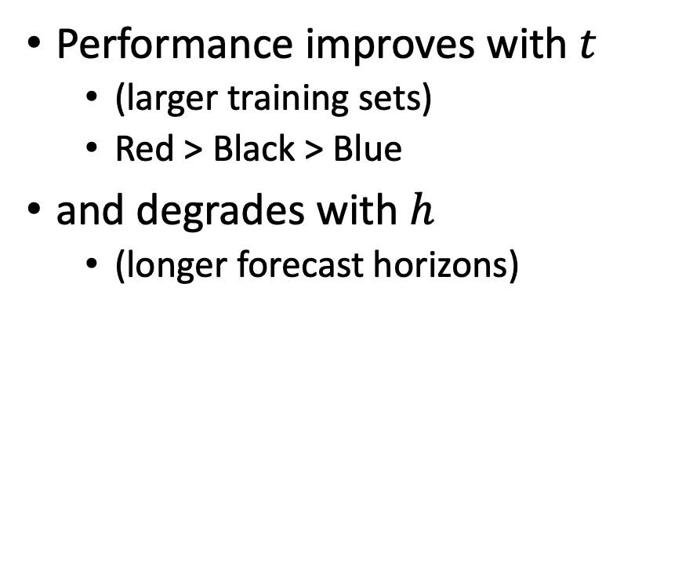
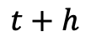
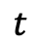
Take-Aways
$$t$$
$$t+h$$
Performance improves with $t$
(larger training sets)
Red > Black > Blue
and degrades with $h$
(longer forecast horizons)

Slide 23
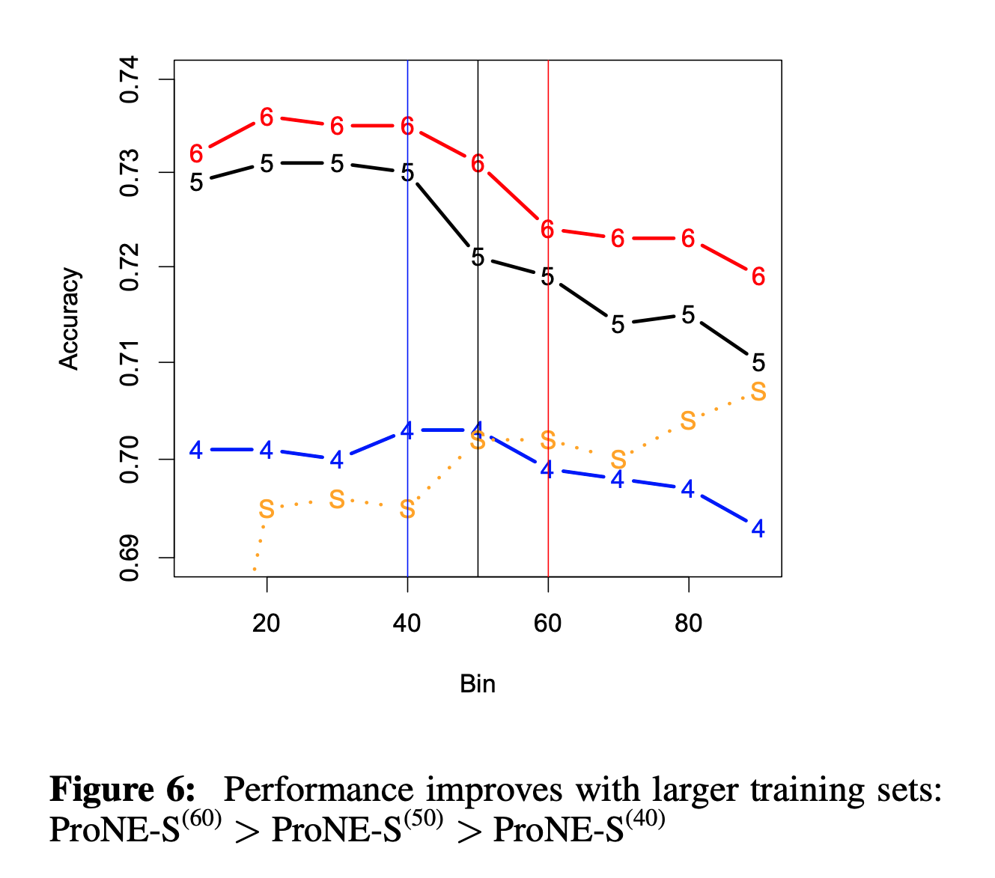
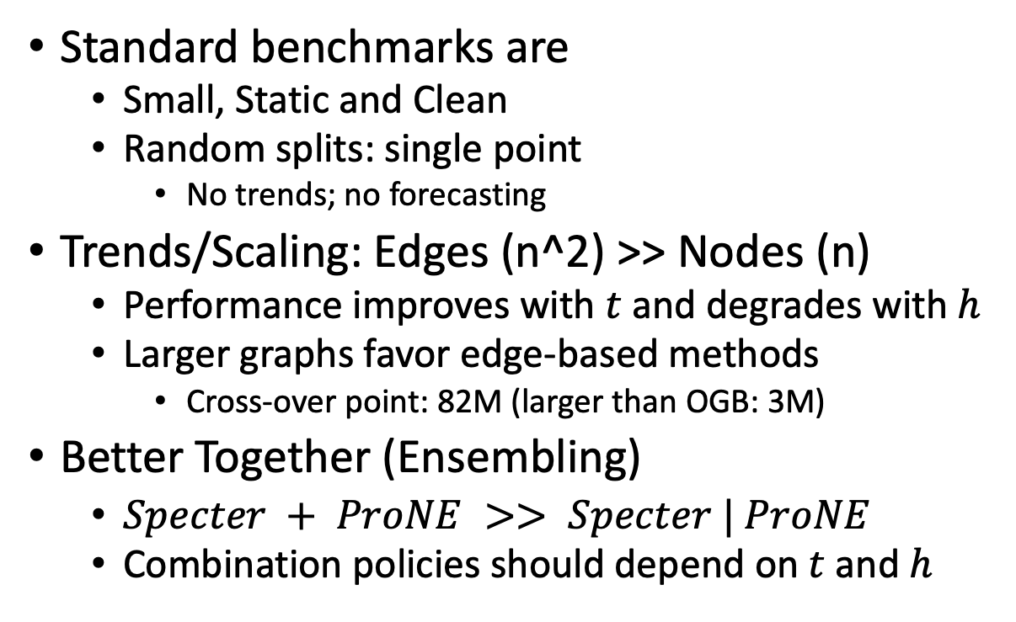
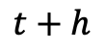
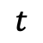
Conclusions
Standard benchmarks are
Small, Static and Clean
Random splits: single point
No trends; no forecasting
Trends/Scaling: Edges (n^2) >> Nodes (n)
Performance improves with $t$ and degrades with $h$
Larger graphs favor edge-based methods
Cross-over point: 82M (larger than OGB: 3M)
Better Together (Ensembling)
$Specter + ProNE >> Specter | ProNE$
Combination policies should depend on $t$and $h$
$$t$$
$$t+h$$

Slide 24
Back-up

Slide 25
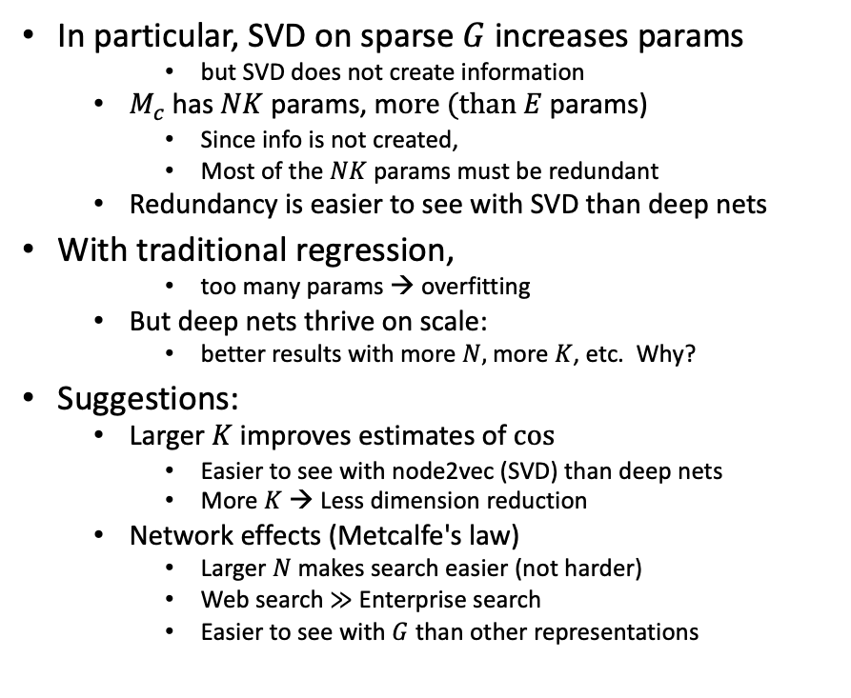
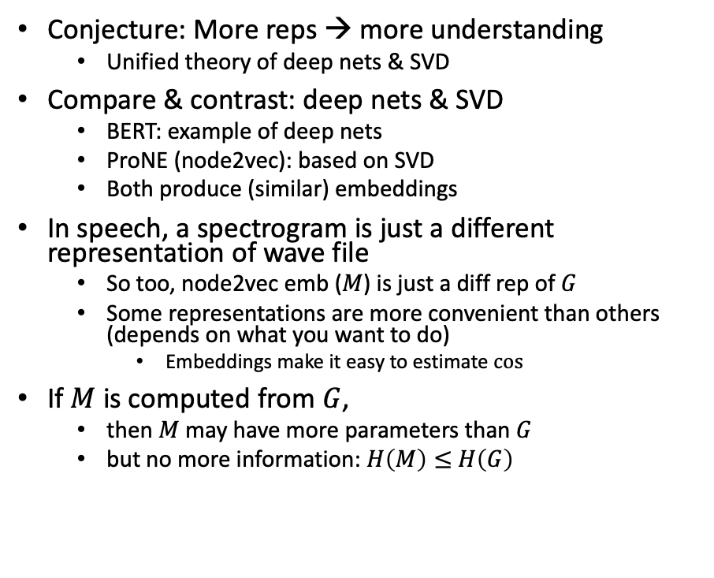
Bigger Stretch: Theoretical combinations of deep nets & SVD
Conjecture: More reps → more understanding
Unified theory of deep nets & SVD
Compare & contrast: deep nets & SVD
BERT: example of deep nets
ProNE (node2vec): based on SVD
Both produce (similar) embeddings
In speech, a spectrogram is just a different representation of wave file
So too, node2vec emb ($M$) is just a diff rep of $G$
Some representations are more convenient than others (depends on what you want to do)
Embeddings make it easy to estimate $cos⁡⁡$
If $M$ is computed from $G$,
then $M$ may have more parameters than $G$
but no more information: $H\left(M\right)≤$ $H\left(G\right)$
In particular, SVD on sparse $G$increases params
but SVD does not create information
$M_{c}$has $NK$ params, m$ore (than E$params)
Since info is not created,
Most of the $NK$ params must be redundant
Redundancy is easier to see with SVD than deep nets
With traditional regression,
too many params → overfitting
But deep nets thrive on scale:
better results with more $N,$ more $K$, etc. Why?
Suggestions:
Larger $K$ improves estimates of $cos⁡$
Easier to see with node2vec (SVD) than deep nets
More $K$ → Less dimension reduction
Network effects (Metcalfe's law)
Larger $N$ makes search easier (not harder)
Web search $≫$ Enterprise search
Easier to see with $G$ than other representations

Slide 26
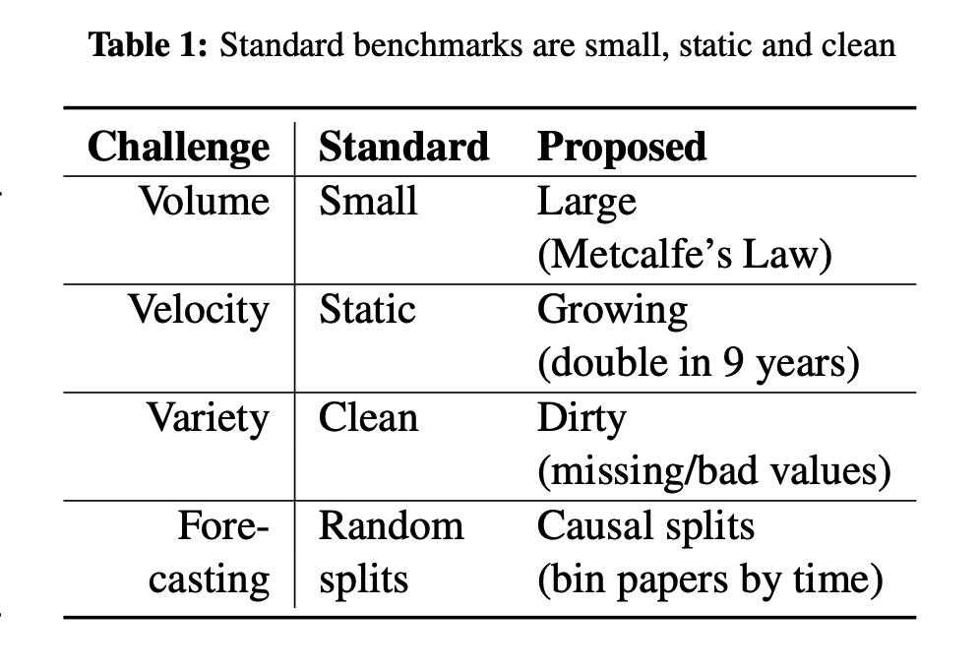
Related Work: OGB (Open Graph Benchmark)

